Slide 1
Modern Web Application Layers
Presentation (HTML/CSS)
Frontend
React Components (JavaScript)
Network (Axios)
API (Express)
Data Access Layer (JavaScript)
Backend
SQL
Postgres Database

Slide 2
Modern Web Application Layers
Presentation (HTML/CSS)
Frontend
React Components (JavaScript)
Network (Axios)
Testing
Thunder Client
API (Express)
Data Access Client
Data Access Layer (JavaScript)
Backend
pgAdmin4
SQL
Postgres Database

Slide 3
Modern Web Application Layers
Presentation (HTML/CSS)
Frontend
React Components (JavaScript)
Network (Axios)
- Get Cats
- Add new Cat
API (Express)
- Update Credit Card
Data Access Layer (JavaScript)
- Cancel Account
Backend
SQL
Postgres Database

Slide 4
Web API Characteristics
Abstraction layer for system or service
Easy to use
Hides underlying details
Available all the time
Secure
Scales
Good documentation

Slide 5

Web API Characteristics
Abstraction layer for system or service
Easy to use
Hides underlying details
Available all the time
Secure
Scales
Good documentation

Slide 6
Web API Anatomy
Authentication
Direct Object Reference
Authorization
Validation
Logging
Error Handling
Business Logic
Data Access

Slide 7
Web API Anatomy
Authentication
Direct Object Reference
Authorization
Validation
Logging
Error Handling
Business Logic
Data Access

Slide 8
Web API Design Guidelines
The frontend of our backend
HTTP URLs
Use plural resource names
http://localhost:5150/cats
Favor one level of nesting
http://localhost:5150/users/1/cars
Use query string when it makes sense
http://localhost:5150/users?type=admin
http://localhost:5150/users?type=admin&age=50
API (Express)
Data Access Layer (JavaScript)
SQL
Postgres Database
HTTP Response Status Codes
200 OK
201 Created
404 Not Found

Slide 9
Web API Design Guidelines
The frontend of our backend
HTTP Verbs
GET: Get resources (200, 404)
PUT: Update resources (200, 404)
POST: Create resources (201)
DELETE: Delete resources (200, 404)
API (Express)
Data Access Layer (JavaScript)
SQL
General
GET requests do not have a request body
Postgres Database

Slide 10
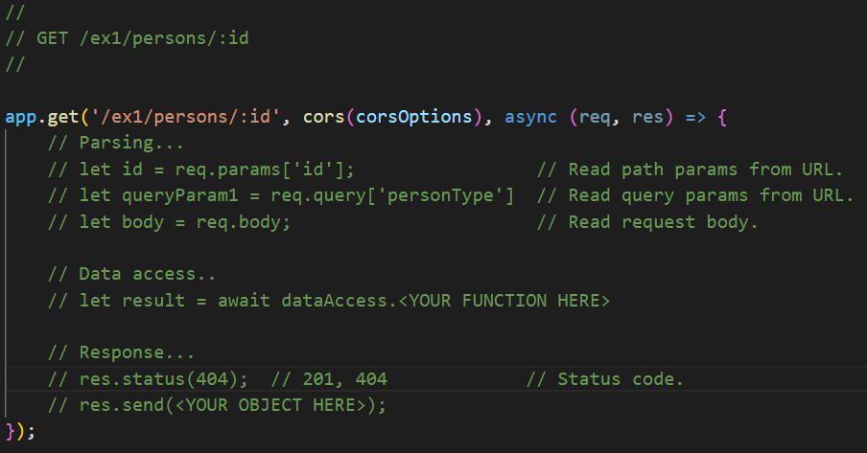
Web API Template
For new endpoints, copy & paste the following:
api.js.template

Slide 11

Create Good APIs!

